Slide 1
Centrality
Who are the most important actors (nodes) in a network?
Answers:
  The nodes that are connected to the most other nodes (Degree)
    Or the nodes that are connected to nodes that connect to the most other nodes (Eigenvector Power, Bonacich)
  The nodes that can get to all the other nodes in the shortest amount of time (Closeness)
  The nodes that are intermediaries, i.e. nodes that other nodes are more likely to go through to get to other nodes (Betweeness Centrality)
  The nodes that can influence the most other nodes (Friedkin)
Notes:
Note that centrality is usually operationalized with nondirectional data, though the theoretical ideas and assumed models are always directional

Slide 2
Degree Centrality
What does degree indicate?
  “In the thick of things”
  Diffusion point
    Multiple paths in and multiple paths out
  Potential communication level
Notes:
Group measures

Slide 3
Prestige
Out-Degree: Centrality
  High out-degree actors can influence more people
In-Degree: Prestige
  High in-degree actors are contacted by lots of others (popular)
  High in-degree actors are affected (reachable) by lots of others

Slide 4
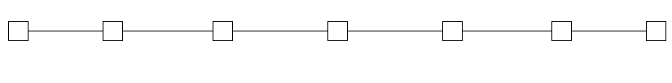
Centrality & Degree
Degree only considers local connections
  Can an actor be central (important) in a network but have a low degree?
  Can two actors have the same degree but one be more important?
  Consider a chain where all nodes except the end nodes have degree of 2

Slide 5
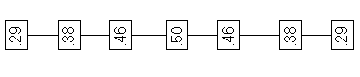
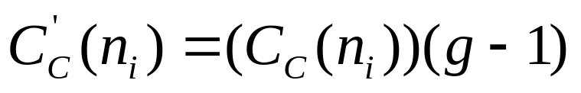
Closeness Centrality
Inverse of the sum of the geodesic distance (shortest path length) of i to each j
Maximum value of
is 1/g-1 when adjacent to all nodes, minumum value is 0
Notes:
Go OVER EQUATIONS

Slide 6
Betweeness Centrality
Actors can have low degree but because they are “bridges” between other actors they are very important (central)
If a bridge were to disappear, many actors would not be able to reach other actors
Dependency and non-substituability
Notes:
Go over exchange theory
A power over B if B dependent on A
Network terms means that B has tie to A, if no tie, no dependency, no power
A’s with more exchange ties to larger number of B’s more powerful
But substitutability: other A’s that B can get resources from
So A is more powerful, and B more dependent on A, if B’s only tie is to A1, and not tied to other A’s
This makes A a bridge or resource point.

Slide 7
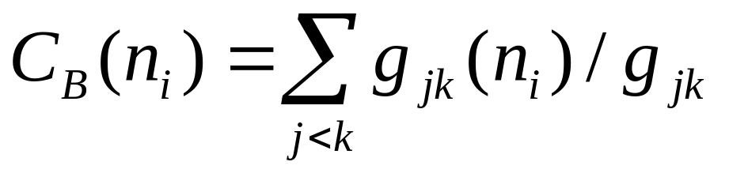
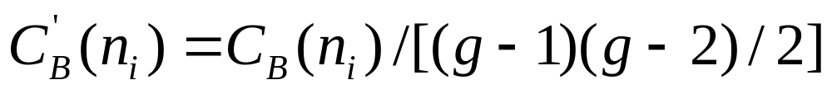
Betweeness Centrality
Where g_{jk} = number of geodesics connecting jk
g_{jk}(n_{i}) = number of geodesics connecting jk that actor i is on
Normalized by:
Actor can block communication(transactions) between j and k
Actor is a switch that can relay communications (resources), i.e. has control
Notes:
volume of traffice through i, like a bottleneck

Slide 8
Information Centrality
Betweeness Centrality only counts geodesics
What if the actor is not on the shortest path between jk?
Why not consider all paths from j to k, and weigh them by their length?
Notes:
this may be what UCINET calls flow betweeness

Slide 9
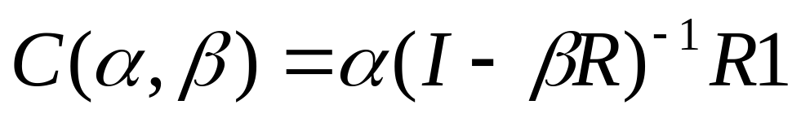
Bonavich’s Eigenvector Centrality
Cook experiments (exchange)
  Actors with lower degree accumulated more resources than those with higher degree
Bonavich’s explanation: the low degree individuals are connected to high degree alters
α is a scaling vector, which is set to normalize the score.
β reflects the extent to which you weight the centrality of people ego is tied to.
R is the adjacency matrix (can be valued)
I is the identity matrix (1s down the diagonal)
1 is a matrix of all ones.
Notes:
The magnitude of β reflects the radius of power. Small values of β weight local structure, larger values weight global structure.
If β is positive, then ego has higher centrality when tied to people who are central.
If β is negative, then ego has higher centrality when tied to people who are not central.
As β approaches zero, you get degree centrality.

Slide 10
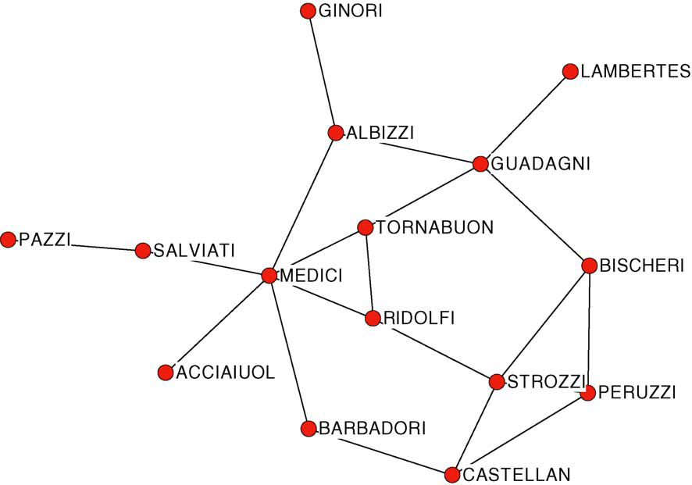
Homework
Notes:
Process:
In UCINET computer centrality measures
Output centrality value data matrix for n=15 actors, merged in individual level data (Excel)
Computed correlation matrix with STATA
All output in Excel Spreadsheet
marital ties
normalized degree is divided by 14 (g-1)

Slide 11
Centrality & Flows/Diffusion (Borgatti)
Degree Centrality: Lots of X flows into and out of a central actor
Closeness Centrality: Flows of X out of an actor will get to everyone in the network the fastest
  Flows of X originating anywhere in the network will reach the actor the fastest (will get infected quickly)
Betweeness Centrality: Flows of X from any i to any j are likely to go through the actor

Slide 12
Borgatti’s Typology:
Flow Trajectory Dimension
Walk
  a sequence of dyads (ordered pairs)
  sequence of nodes and lines
Trail
  a walk in which all lines are distinct
  can not go on same line twice, but can go through same node more than once
Path
  a trail in which all nodes are distinct
  can not go on either same line or through same node more than once
Geodesic
  shortest path between two nodes
Paths, Trails and Walks are random walks with various rules
Geodesic walks require searching, i.e. trying to find the shortest path to some point
Notes:
e.g. start walking anywhere but as you go do not….

Slide 13
Borgatti’s Typology:
Diffusion Mechanism Dimension
Transfer: a flow of X from i → j results in i no longer having x after i has transferred x to j
  x is not duplicated (is not copied)
Duplication: a flow of X from i → j results in j having a copy of X and i retaining the original
How does the duplicating process start out?
  i makes lots of copies of X and sends them all out
  i makes one copy of X and sends it out
Notes:
view actors as state spaces

Slide 14
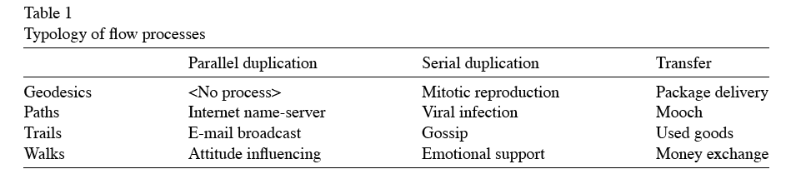
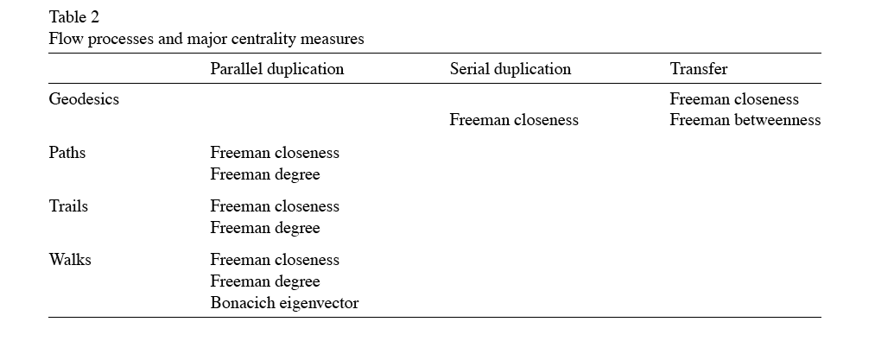
Borgatti’s Typology

Slide 15
Closeness Centrality Underlying Model
Expected time until arrival (e.g., information, infection)
  shortest path model (geodesics), e.g. package delivery
  parallel duplication: spreading along all walks, including geodesic, e.g. receiving an infected email, being influenced by others
Assumes actor knows how to reach target
Note on gossip: does not travel via geodesics but goes at random through network except infomration can’t go over same line
Notes:
confusion in Borgatti defining closeness as some of distances, not inverse of sum.
Borgatti example are indegree (being influenced, receiving a package), i.e. if an event occurs at random anywhere in net, how fast will it get to you
but can think of this in terms of outdegree, i.e. if an actor creates an email virus how quickly will it affect everyone, a function of their closeness in network.

Slide 16
Betweeness Centrality Model
High Betweeness Centrality indicates that flow (traffic) is more likely to go through the node
When some actor wants to get some X to another actor
  Have to make a choice how to send it
  Choose that path that is shortest (Why?)
  Intermediary with high betweeness centrality will be more likely to be a relay person in all such transfers
Notes:
choice implies a one time thing, once sent can’t resent.
Information betweeness relaxes some of the assumptions (i.e. actor can choose a path that is longer than the geodesic), but still assumes one time transfer

Slide 17
Eigenvector Centrality
Influence Measure: Low degree actor can be central (influential) if ties to high degree actors
Measure counts number of walks of all lengths that reach (or emanate out from) an actor
  Could influence or be influenced through a walk, a trail or a path
Parallel flows: Process can start out from one actor then spread through parallel duplication along random paths
Notes:
Indegree formulation: Low degree person can be infected even if in contact with only 1 other person if that person is a high indegree actor (e.g., lots of sex partners)

Slide 18
Degree Centrality Model
No indirect links/chains (rare)
Immediate Effects (or influence)
  Probability in the next moment of time of receiving X (or infecting another person)
  Parallel duplication (not serial) at random
Eignevector Centrality: long-term direct and indirect effects
Degree Centrality: short-run (immediate) direct effects
Notes:
Note relation degree and eigenvector measures:
Recall Bonacich created it to deal with Cook finding of low degree rich people. Such people are connected to lots of others but through indirect links via hubs

Slide 19
Implications
Measures of centrality based on an implicit model of flows
Most models assume that flows either go along shortest path OR go along random paths simultareously (parallel duplication)
When is shortest path assumption valid?
Many flows move randomly (with some constraint rules) beginning with dispersion (parellel duplication) and continuing through dispersion
Other flows move randomly with transfer
Some flows move randomly (with some constraints) but only one step at a time (e.g., gossip, viruses)
Notes:
Under those conditions what determines node centrality?
Degree doesn’t matter because it is one step at a time
Betweeness centrality and closeness irrelevant because flow is random (not shortest path)
RANDOM PROCESSES THAT DO NOT ALLOW FOR DISPERSION (BUT WHAT IS DIFFERENCE BETWEEN EMAIL BROADCASTING OF A RUMOR AND VOICE)
divisibility

